Slide 1
Finding Stock Market Inefficiencies
Analysis by Brian Bentson

Slide 2
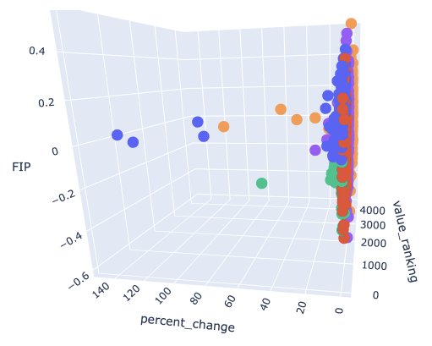
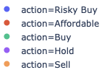
Business Goal find which stocks offer the unique combination of low cost, growing and low volatility
1
Use machine learning to find which companies are:
Inexpensive, relative to their performance
Growing in value
Low volatility
Use anomaly detection to find data quality issues
Visually interact with key KPI’s to research potential stock purchases and sales
2
3

Slide 3
Data Overview
FMP
Sourced data from FMP’s API
4311 stocks after removing null or negative values and removing highly volatile sectors
Pulled company profile information, historical performance metrics and stock price
Financial Modeling Prep

Slide 4
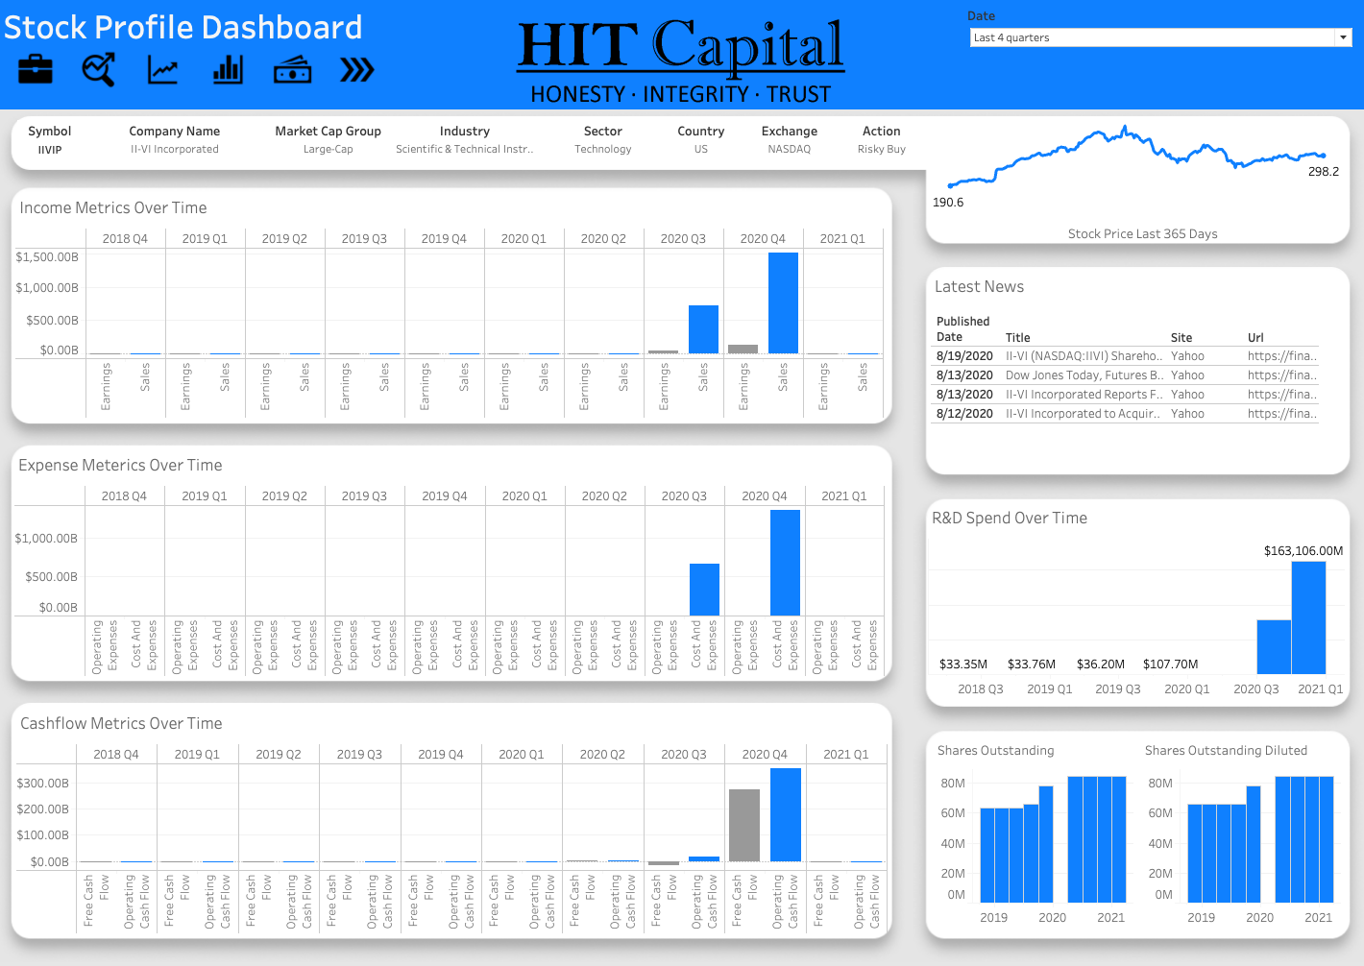
Machine Learning Results 96% Overall Accuracy in Predicting Action
Classification of Buy, Hold, Sell
Anomaly Detection
Percentage Correctly Classified
Symbol | Revenue Per Share | PE Ratio | PS Ratio | EV to EBITDA | EV to Free Cashflow | EV to Operating Cashflow
IIVIP | 26,456 | 0.14 | .01 | .07 | .1 | .07
Sell
98%
Affordable
96%
Action
Hold
94%
Buy
93%
Risky Buy
92%
Model Feature Importances
EV to Operating Cashflow
EV to EBITDA
EV to Free Cashflow
Percent Change
Price to Sales Ratio

Slide 5
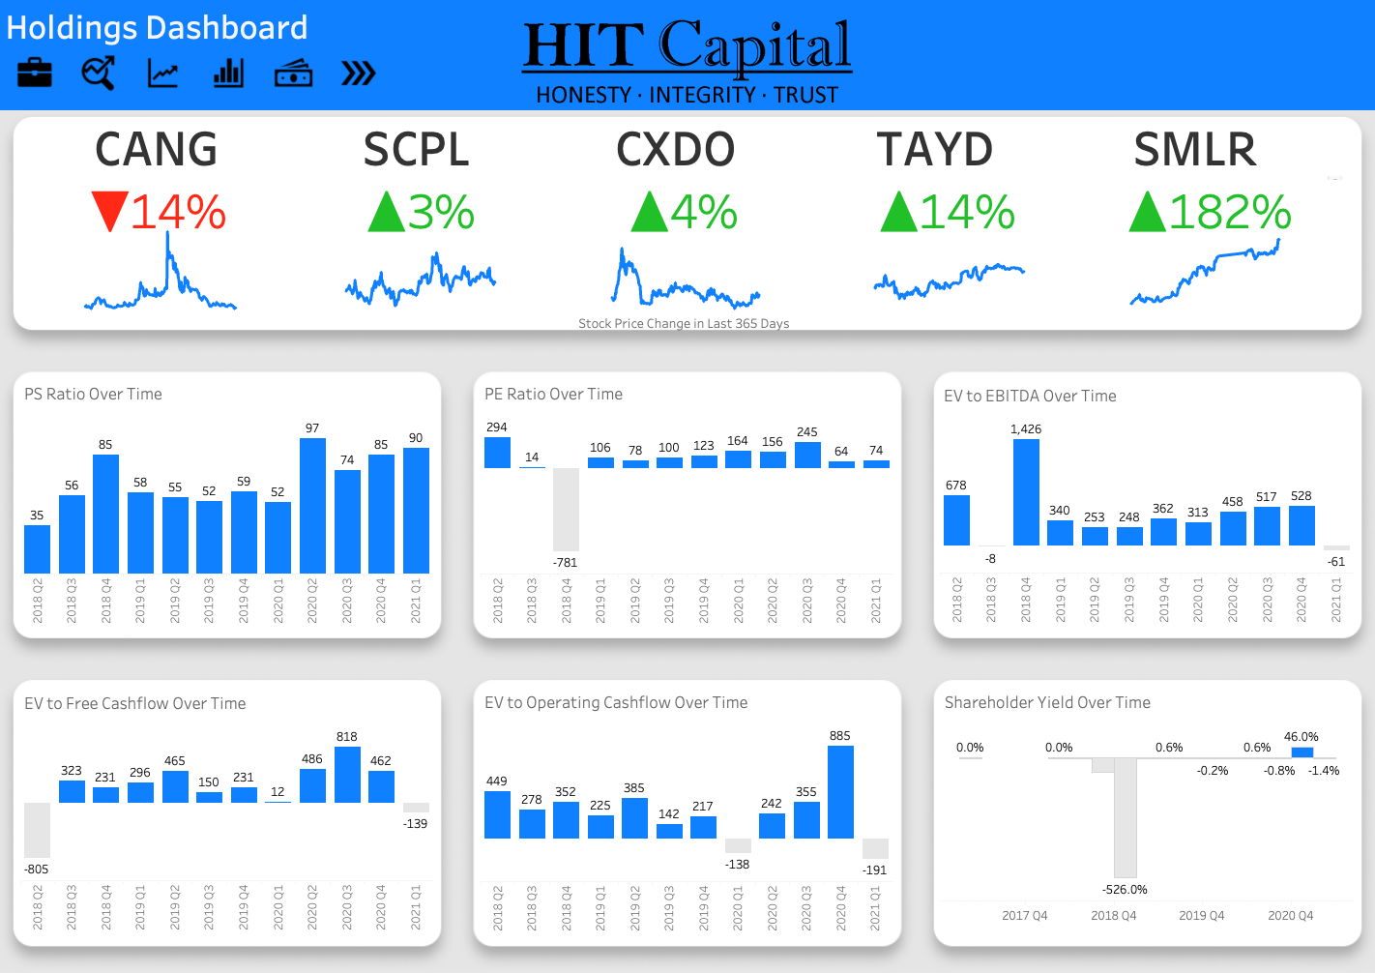
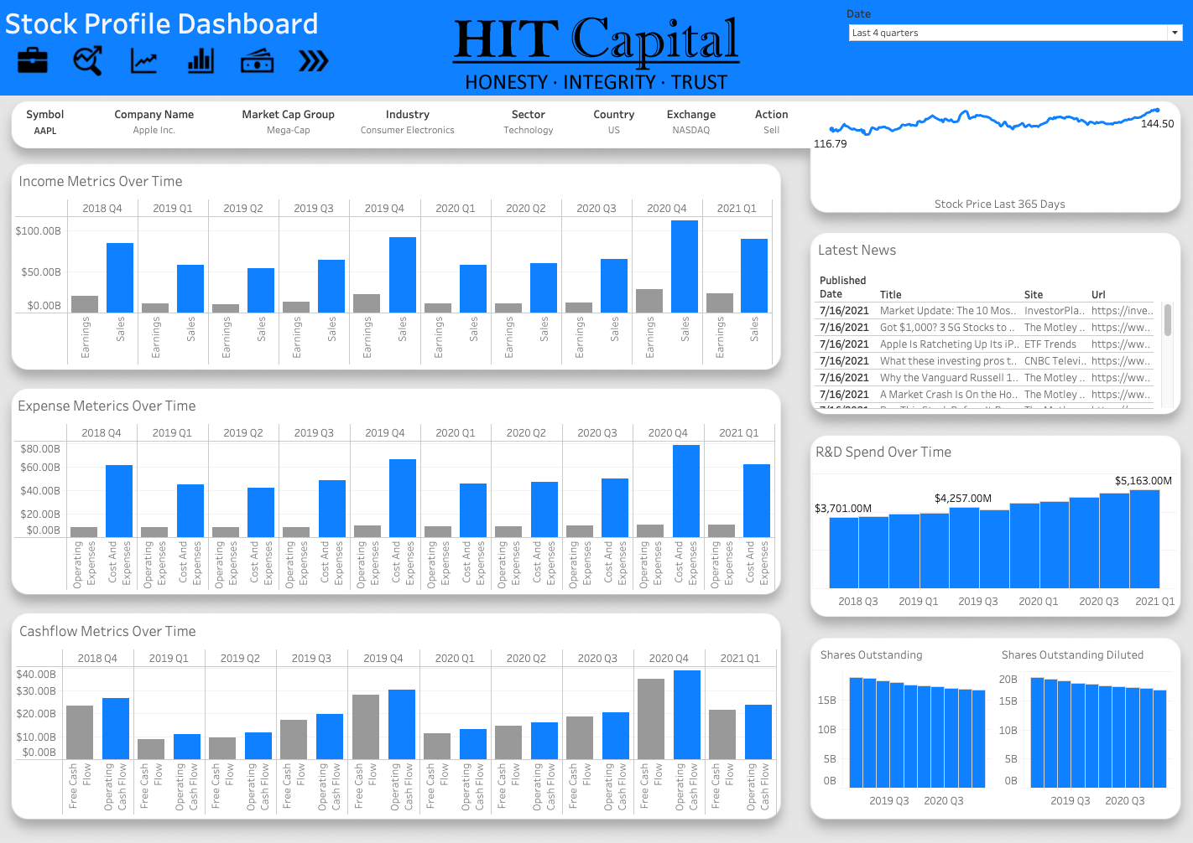
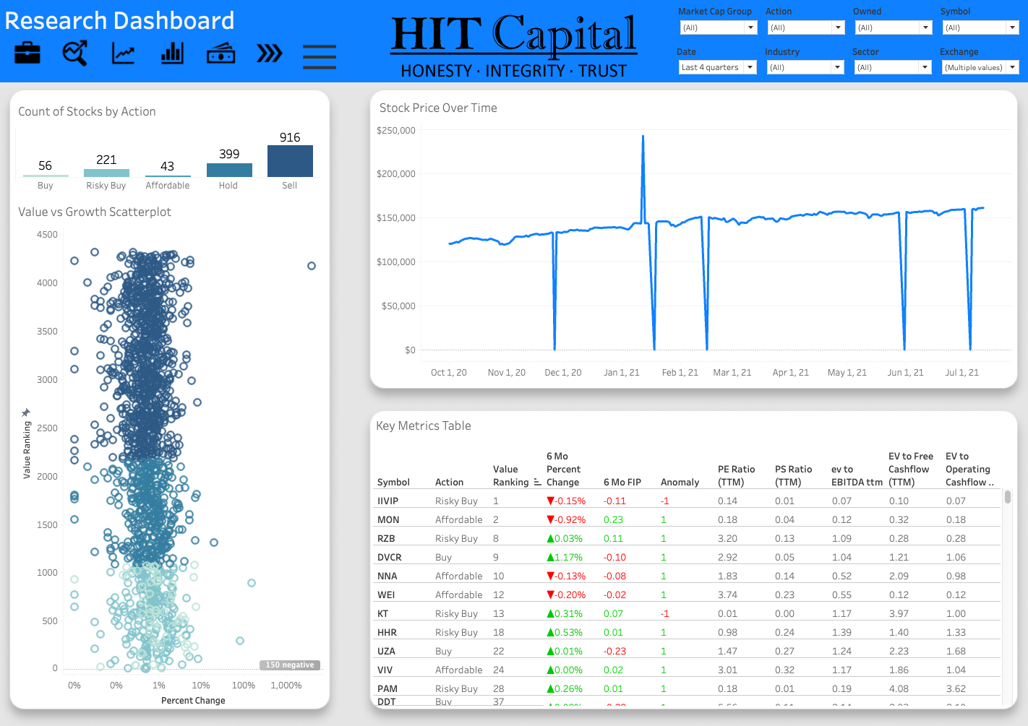
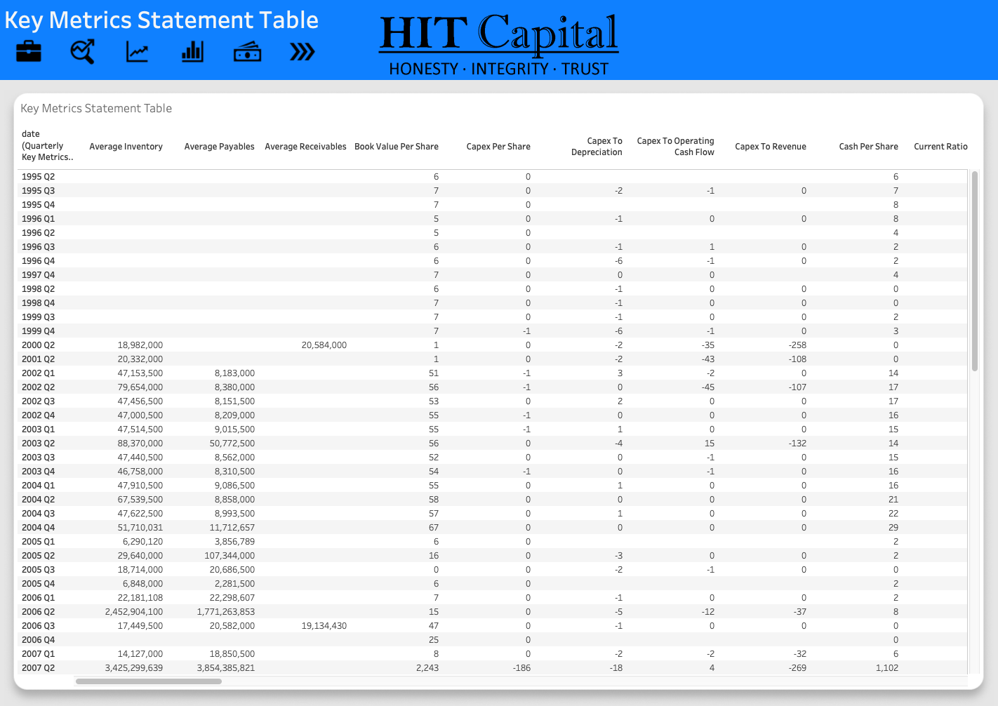
Dashboard
1
View performance of current holdings for potential sale
Research new companies to buy
Validate underlying data quality
2
3

Slide 6
Dashboard Demo

Slide 7
Thank you
Questions?

Slide 8
Appendix

